Slide 1
Dom & java script

Slide 2
What is dom?
"The W3C Document Object Model (DOM) is a platform and language-neutral interface that allows programs and scripts to dynamically access and update the content, structure, and style of a document."
When a web page is loaded, the browser creates a Document Object Model of the page.
The HTML DOM model is constructed as a tree of Objects.

Slide 3
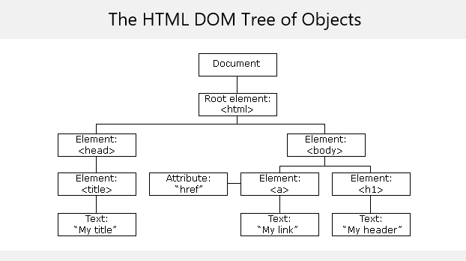
Html dom

Slide 4
Html dom
The HTML DOM is a standard object model and programming interface for HTML. It defines:
The HTML elements as objects
The properties of all HTML elements
The methods to access all HTML elements
The events for all HTML elements

Slide 5
HTML dom methods
Dom methods are actions you can perform.
All HTML elements are defined as Objects.
Using a programming interface the values of Objects can be changed.
A property is a value that you can get or set (like changing the content of an HTML element).
A method is an action you can do

Slide 6
HTML dom example
<html> <body> <p id="demo"></p> <script> document.getElementById("demo").innerHTML = "Hello World!"; </script> </body> </html>

Slide 7
Html dom example
getElementById is an HTML DOM method
In the example the getElementById method used id="demo" to find the element
innerHTML is the property of the element.

Slide 8
The html dom document
Html DOM Document object is the owner of all other objects.
If you want to access any element in an HTML page, you always start with accessing the document object.

Slide 9
Methods to find an element.
Method | Description
document.getElementById(id) | Find an element by element id
document.getElementsByTagName(name) | Find elements by tag name
document.getElementsByClassName(name) | Find elements by class name

Slide 10
Change values of elements
Method | Description
element.innerHTML = new html content | Change the inner HTML of an element
element.attribute = new value | Change the attribute value of an HTML element
element.setAttribute(attribute, value) | Change the attribute value of an HTML element
element.style.property = new style | Change the style of an HTML element

Slide 11
Adding and deleting elements
Method | Description
document.createElement(element) | Create an HTML element
document.removeChild(element) | Remove an HTML element
document.appendChild(element) | Add an HTML element
document.replaceChild(element) | Replace an HTML element
document.write(text) | Write into the HTML output stream

Slide 12
HTML adding event handlers
This code will add an event handler for the given element:
document.getElementById(id).onclick = function(){code}

Slide 13
Changing the output stream
The output stream can be changed by using the write method.
document.write() can be used to write directly to the HTML output stream

Slide 14
Changing the Value of an Attribute
The value of an attribute can be changed by using the following coode:
document.getElementById(id).attribute=new value

Slide 15
Example of changing an attribute
<!DOCTYPE html> <html> <body> <img id="myImage" src="smiley.gif"> <script> document.getElementById("myImage").src = "landscape.jpg"; </script> </body> </html>

Slide 16
HTML DOM Events
A JavaScript can be executed when an event occurs, like when a user clicks on an HTML element
To execute code when a user clicks on an element, add JavaScript code to an HTML event attribute
onclick=JavaScript
Onload=JavaScript
Onchange=JavaScript
Onmousedown=JavaScript
onmouseup =JavaScript
Onfocus=JavaScript
List of event:
http://www.w3schools.com/jsref/dom_obj_event.asp

Slide 17
HTML DOM Events-example
<!DOCTYPE html> <html> <body> <h1 onclick="this.innerHTML='Ooops!'">Click on this text!</h1> </body> </html>

Slide 18
QUESTIONS ?

